Slide 1
Welcome Parents! Open House Welcome Parents Open House Thursday September 26, 2019 Forensic Science 2
Mrs Diaz – Room 374

Slide 2
About Me: Mrs Diaz
I have been teaching at Miami Beach Senior High for 19 years
I currently teach 4 classes of Forensic Science 1 Honors and 2 classes of Forensics 2.
My degree is in Biology Education with a minor in Chemistry
I have planning during Period 1 and 2 which are the best times to meet or call for conferences
Communication via email is the best way to get a more immediate response from me at Ldiaz@dadeschools.net

Slide 3
Forensic Science 2 Topics The syllabus was sent home the first day of school – You should find a copy at the front of the room with all course requirements and info
Forensic Science Overview and Basics Review
Physical Evidence Types and Importance Review
Drugs and Toxicology
Fingerprints Review and Advance techniques – Cyanoacrylate Fuming
DNA
Microscopic Evidence Introduction
Hairs and Fibers
Death, meaning Manner Mechanism and Time
Forensic Anthropology /Entomology
Casts and Impressions
Ballistics
Toolmarks
Properties of Matter and Analysis of Glass
Blood Spatter Advanced
Forensic Science and the Internet
Odontology – Bitemarks as evidence
Forensic Science is the application of science to those criminal and civil laws. It has become a comprehensive subject incorporating Biology, Chemistry, Physics, Entomology, Earth Science, Anatomy and Physiology as well as other aspects of Science.
Students in Forensic Science 2 should have taken Forensics 1 last year or the year before
This course counts as an elective class not and does not fulfill the science requirement for graducation
Almost all topics will have a lab
Or hands on activity associated with it
Attendance is very important because
Makeups for labs are not always
possible

Slide 4
Old Forensic Science Textbook
Textbook is only available for use in class due to current supply
Chapters from book and powerpoints are available in pdf form on the school website and can be downloaded or printed.

Slide 5
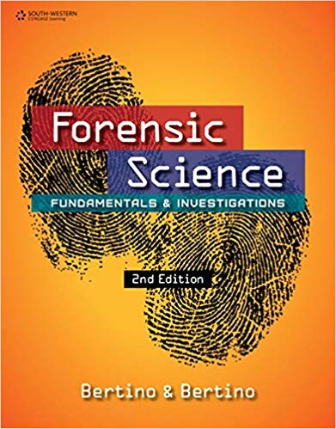
New Textbook Forensic Science Fundamentals and Investigations 2nd edition Textbook can be found on the student portal textbook link Students may also check out a book if they prefer

Slide 6
School and Class website
Class syllabus and parent letter are posted
Powerpoints for all topics are available for download or review on edmodo
All chapters from the old textbooks are available in pdf format for viewing, download or printing.
Edmodo codes are also posted on the schools website
Miami Beach Senior High Website

Slide 7
Edmodo
Similar platform as Facebook
Assignments, important notifications, links to videos, worksheets are all posted on Edmodo. Assignments can also be turned in via Edmodo
Parents can sign up with code g2zpy7 at www.Edmodo.com
DIAZ EDMODO PAGE

Slide 8
Science Fee
$5.00 pay at treasurers office and show receipt to me for documentation or pay online via student and parent portal. Under apps and services find OSP – online school payments. Locate our school then find the teacher or class you would like to pay. Teacher should receive an email receipt with the students name that paid.
Science fees are very important and it helps our department order lab supplies for hands on activities.
This is the first year for this class and we are in need of new lab supplies to supplement the lessons.
Adopt a classroom and donorschoose.org is also an option for any parents that would like to donate to any teacher registered in the school that has a special request for funding for a project or classroom supplies

Slide 9
General points every student should follow
Wear Uniform and ID every day to every class
Bring all required class supplies every day
Get a good nights sleep
Be on time to every class
Electronic devices and phones need to be put away unless allowed for an assignment
Ask for any make up work if absent but make sure the absence is excused
Excused absence does not = Excused work
If you don’t understand something in class -
ASK

